Slide 1
物聯網實務 HW8
電機碩一 11278008 林佳慧
日期:2023/11/01

Slide 2
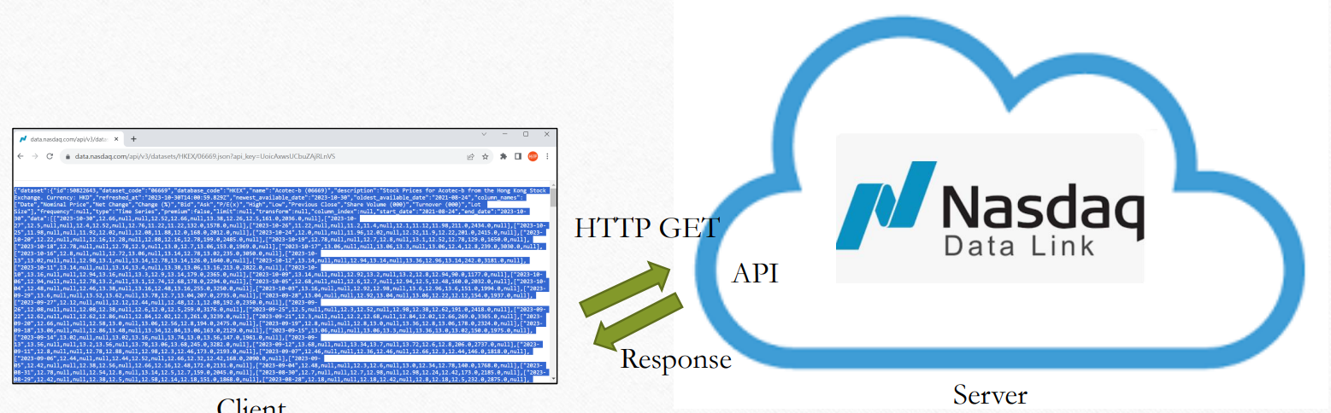
Exercise 8-1

Slide 3
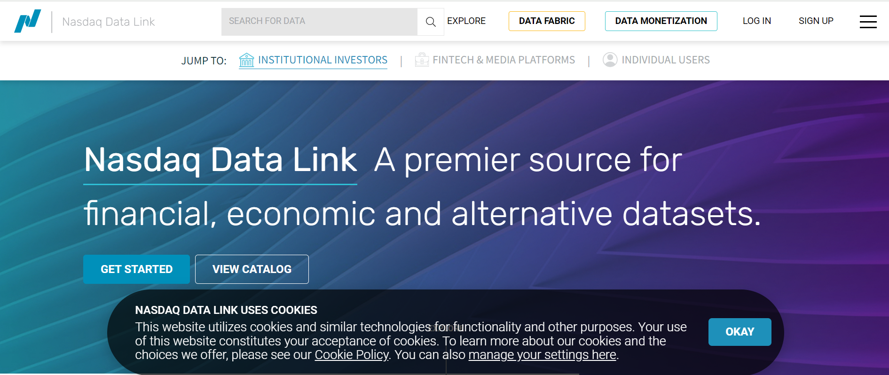
Nasdaq
https://data.nasdaq.com/login

Slide 4
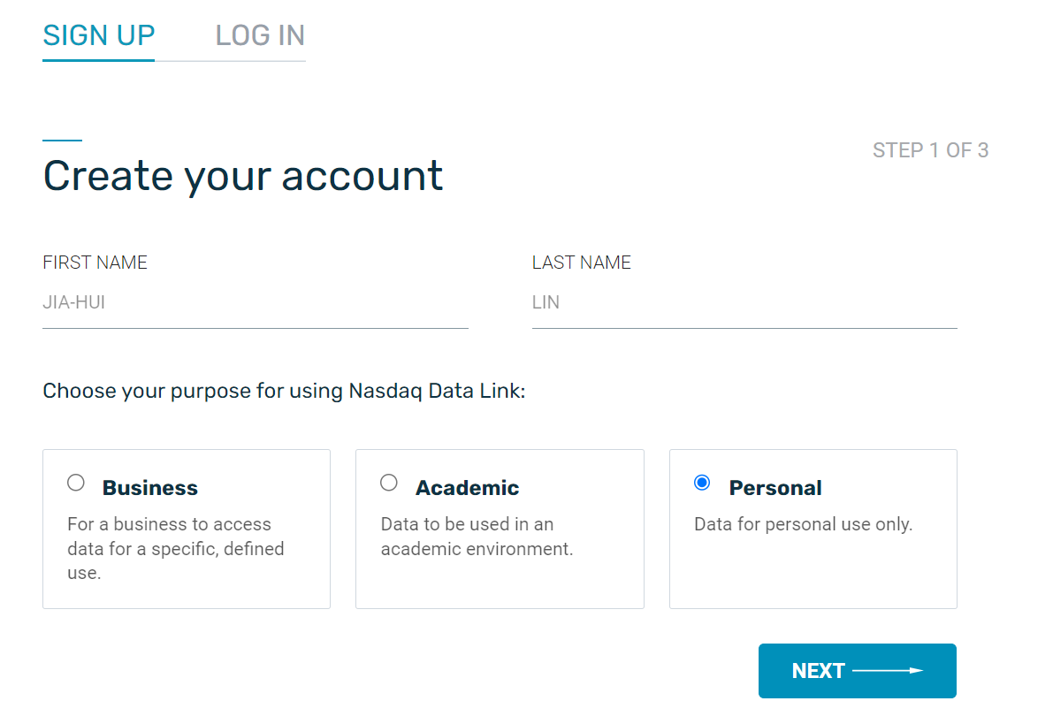
Create a free account on Quandl

Slide 5
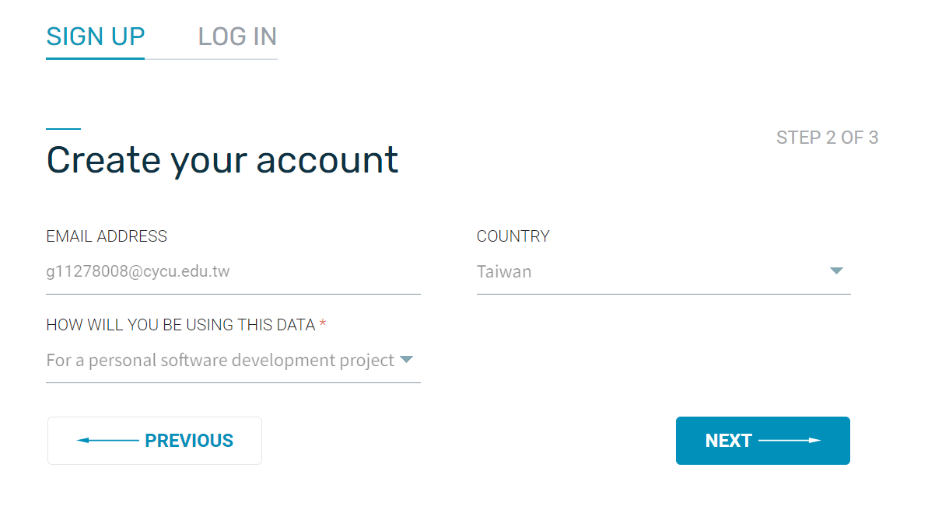
Create your account

Slide 6
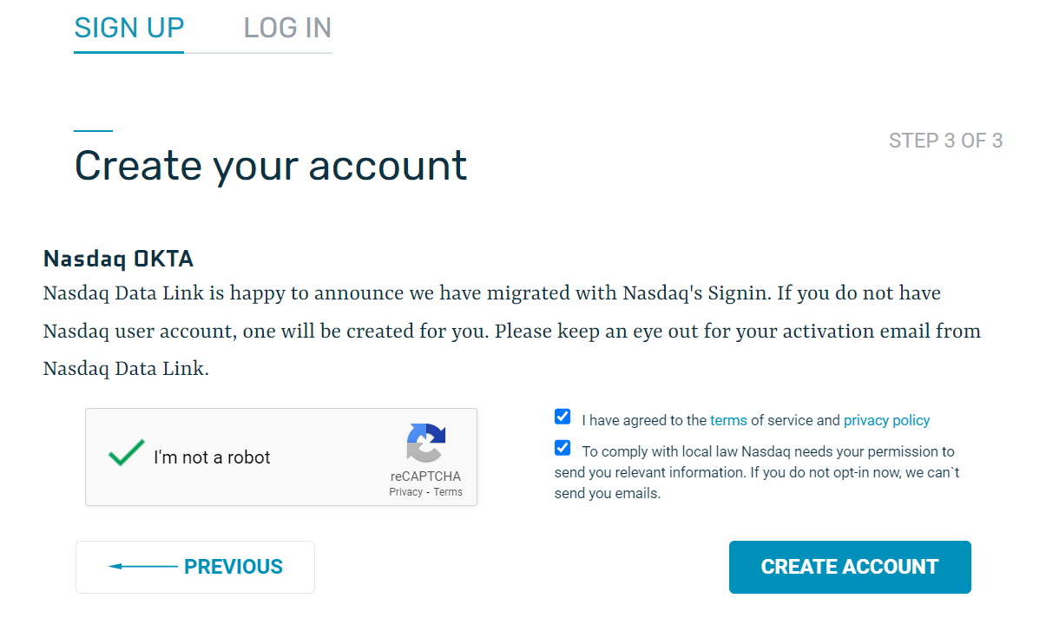
Create your account

Slide 7
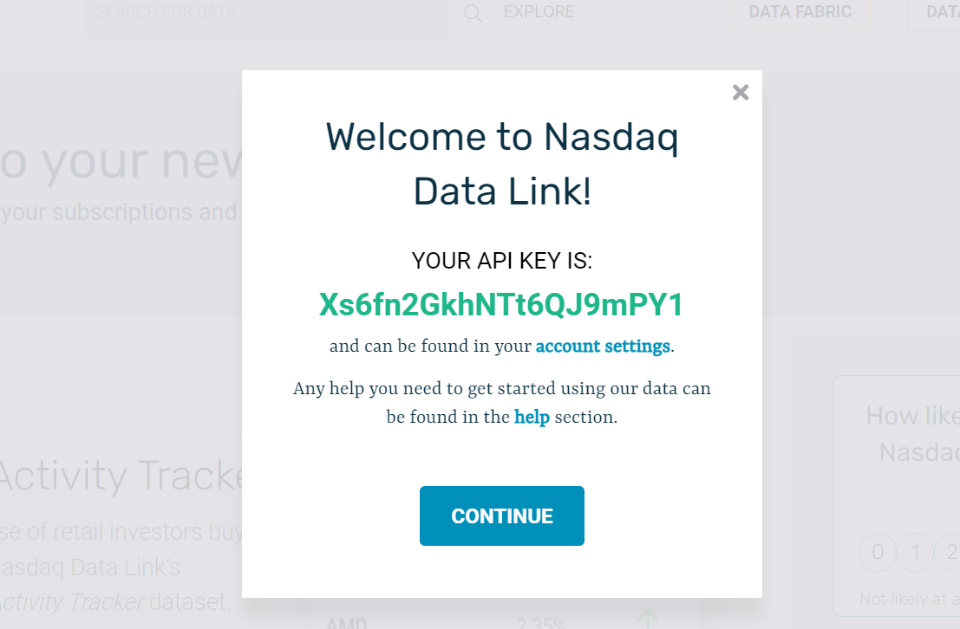
API KEY

Slide 8
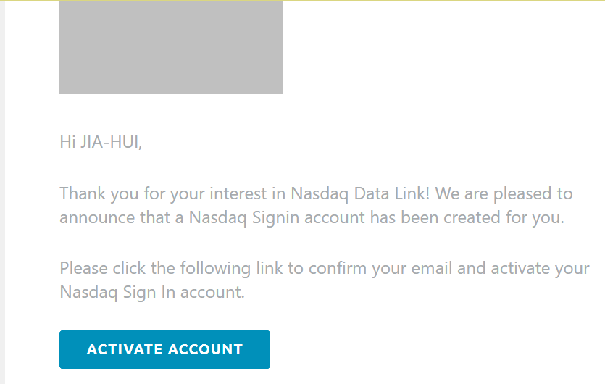
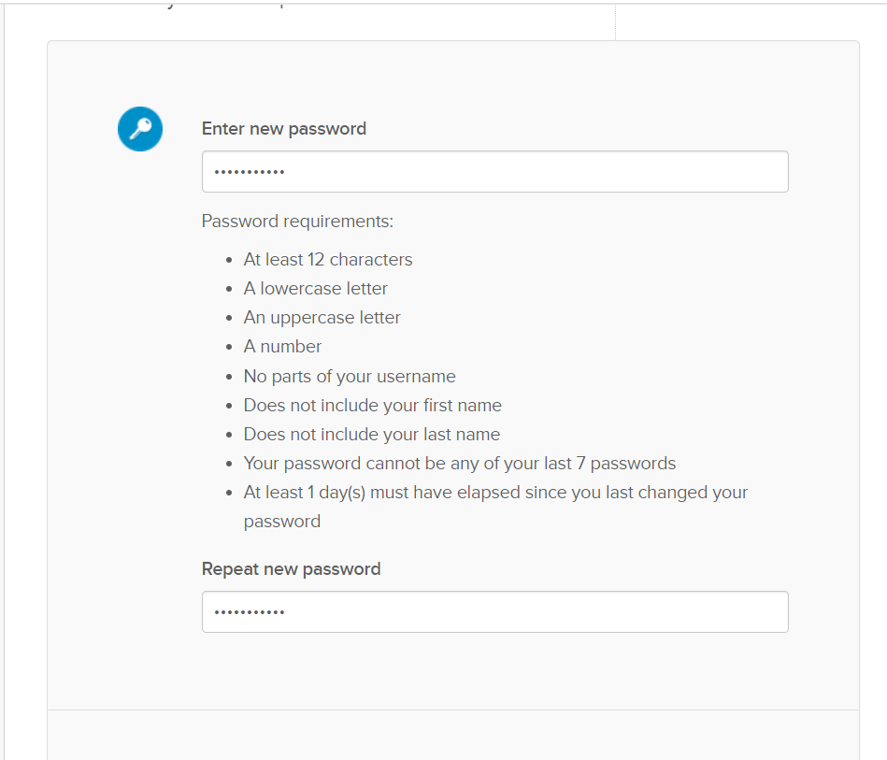
ACTIVATE ACCOUNT
Password
去EMAIL收件，啟動帳號

Slide 9
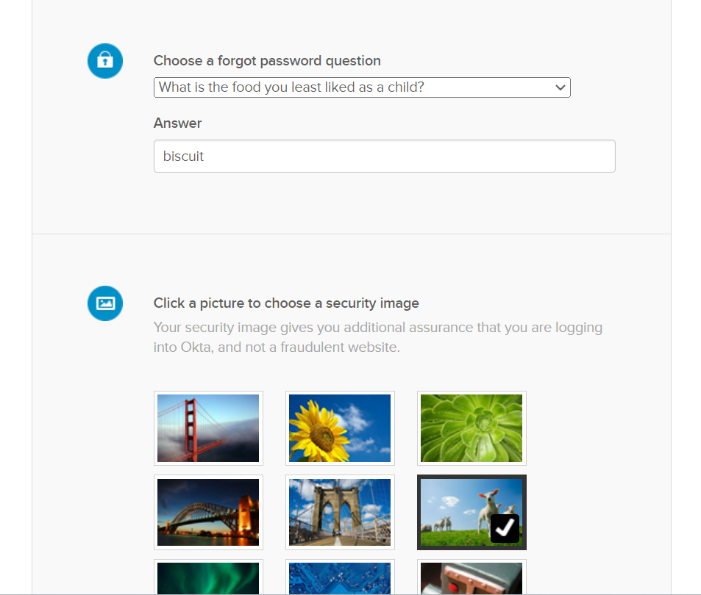

Slide 10
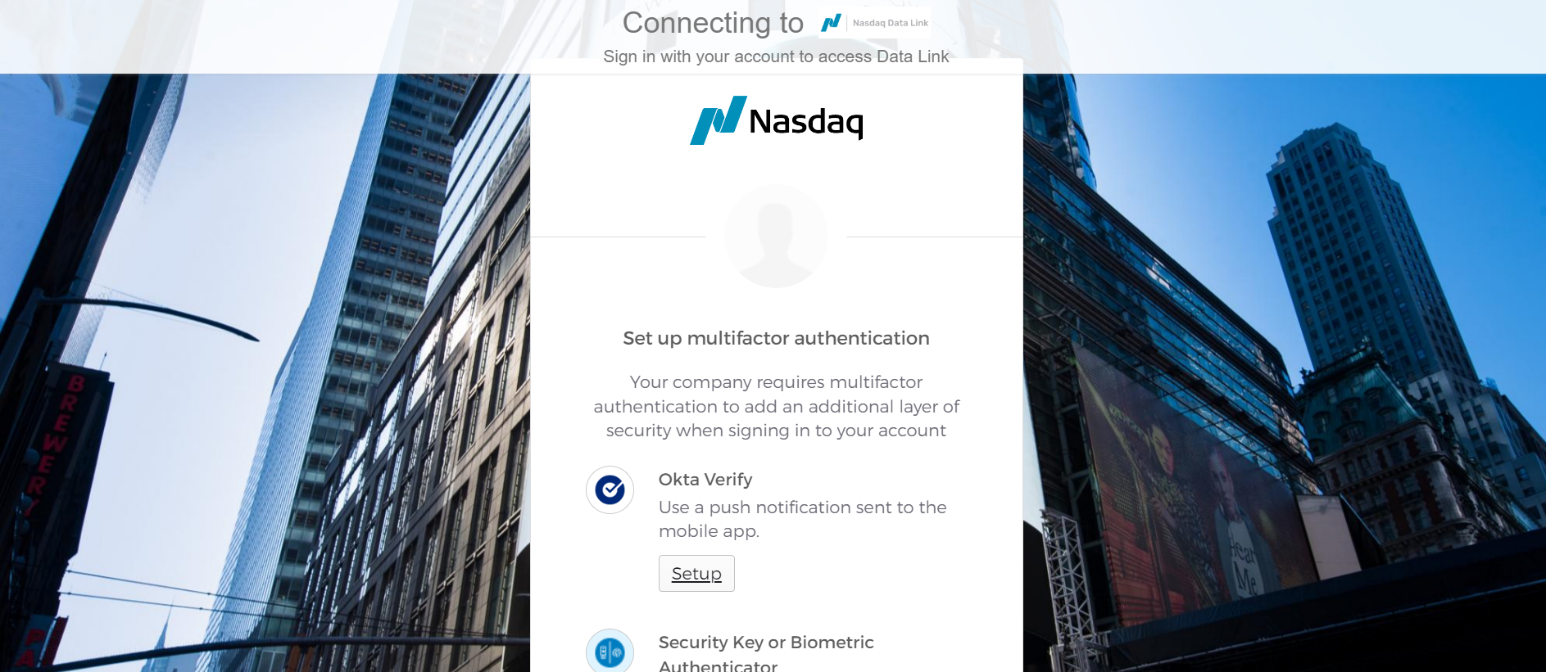
Two-factor authentication
擇一進行認證

Slide 11
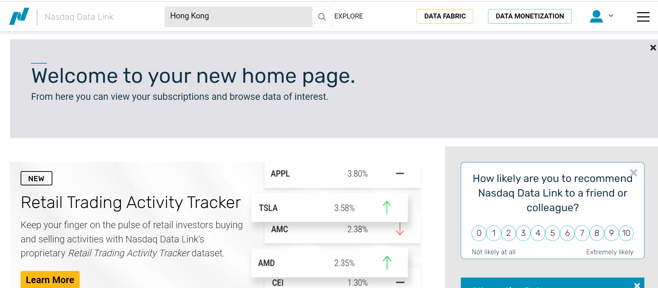
1
2

Slide 12
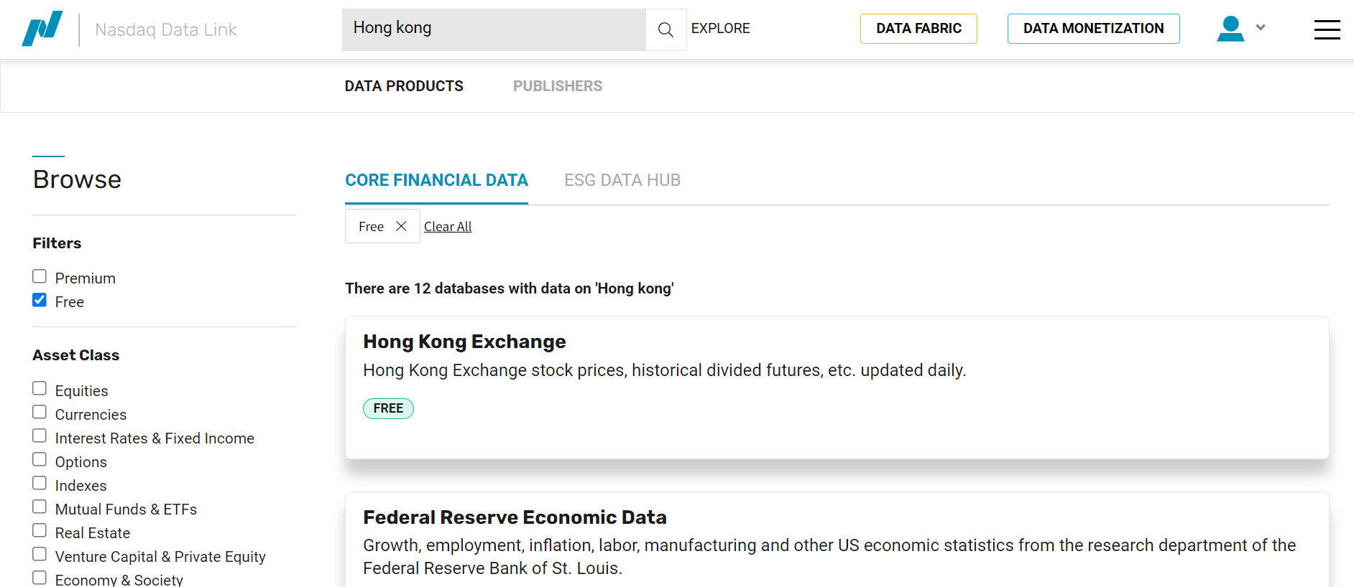
4.Hit
3.

Slide 13
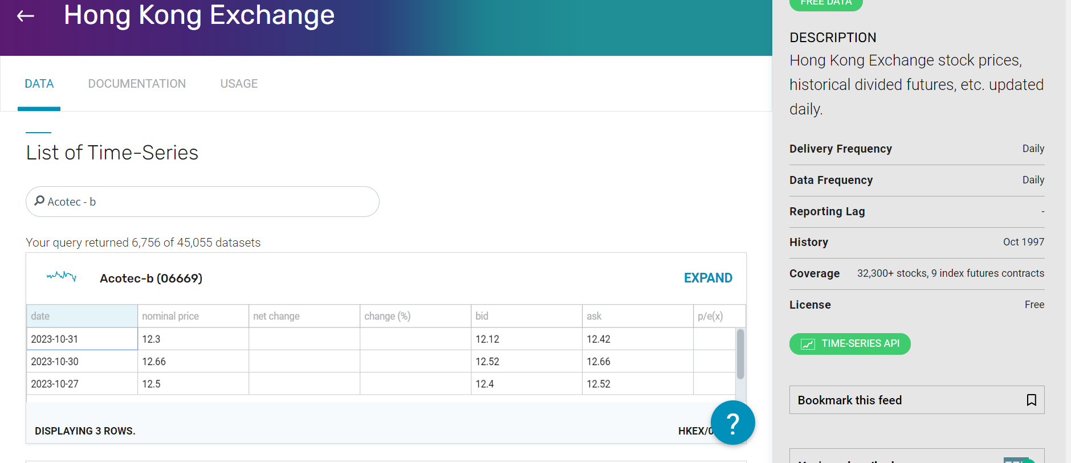
EXPAND

Slide 14
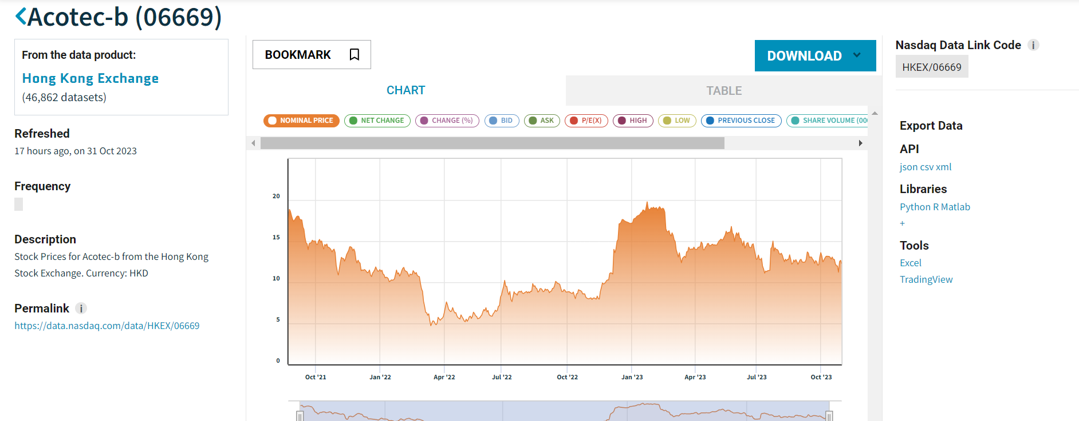
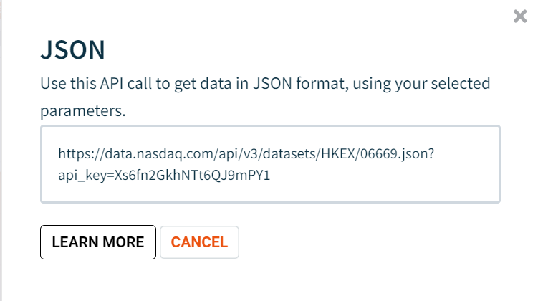
json
Copy

Slide 15
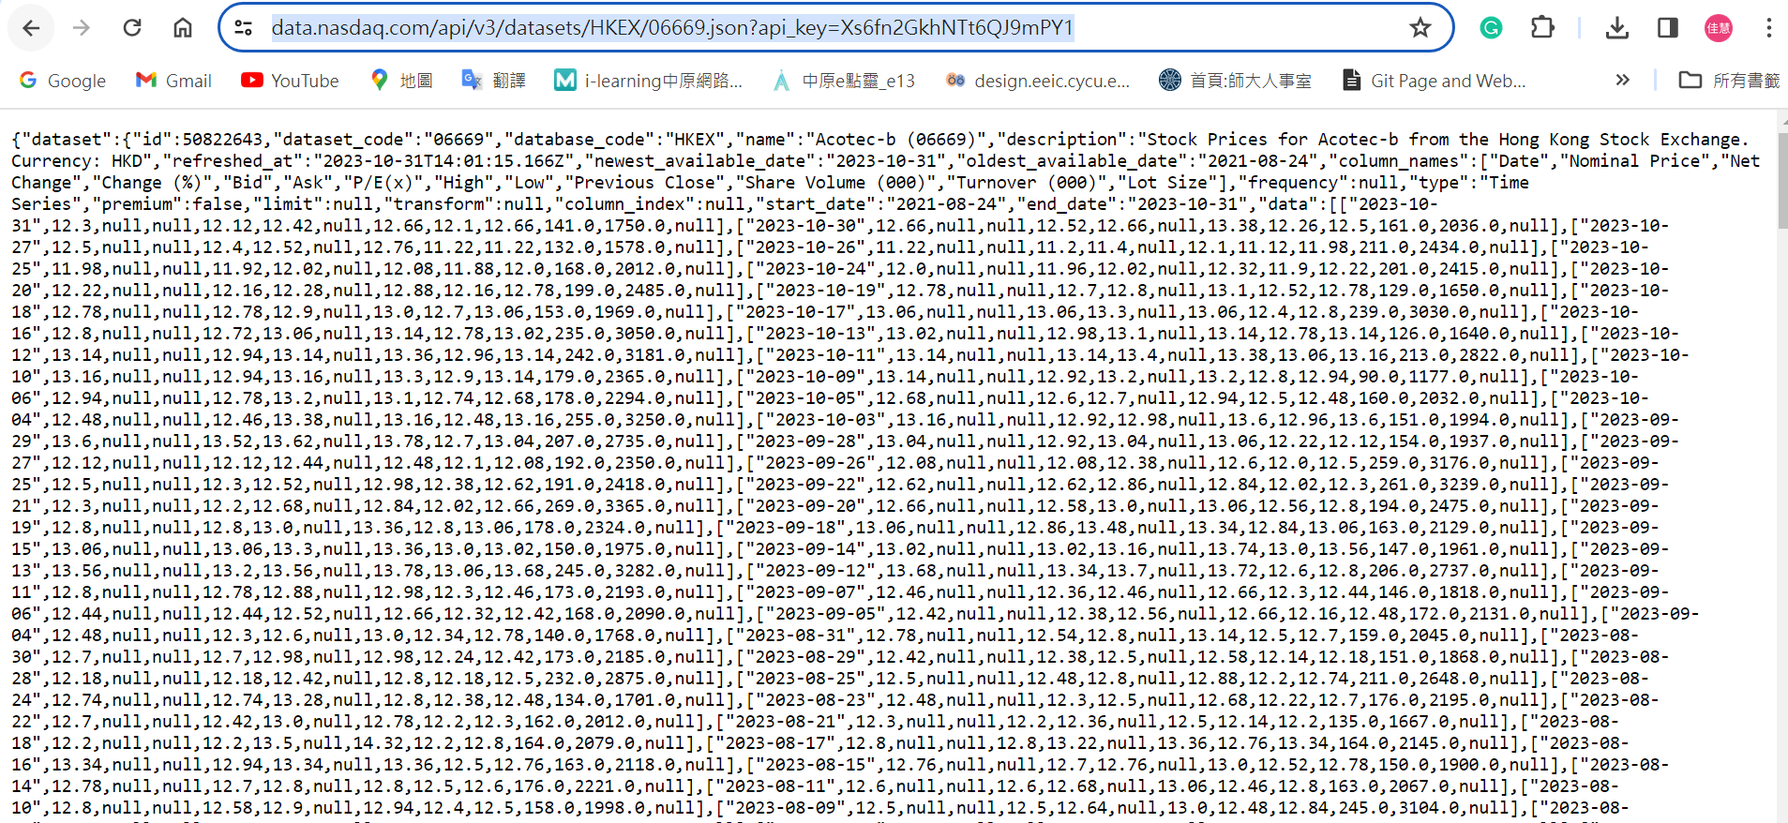
Paste

Slide 16
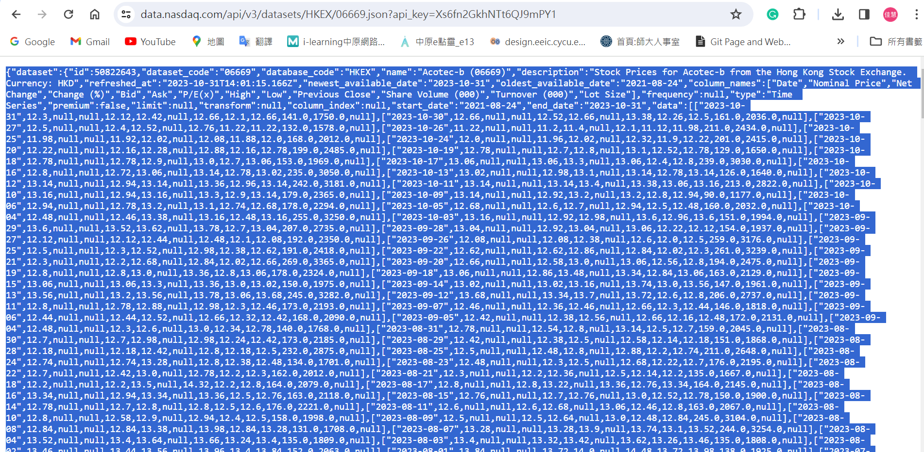
1.Ctrl+A
2.Copy

Slide 17
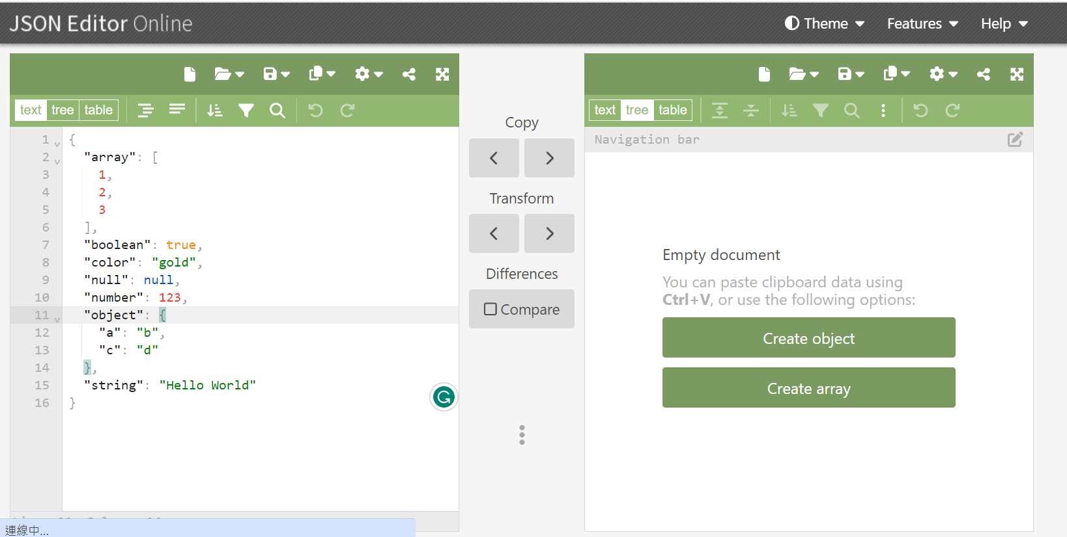
3
c
1.Ctrl+A
2.Paste
https://jsoneditoronline.org/

Slide 18
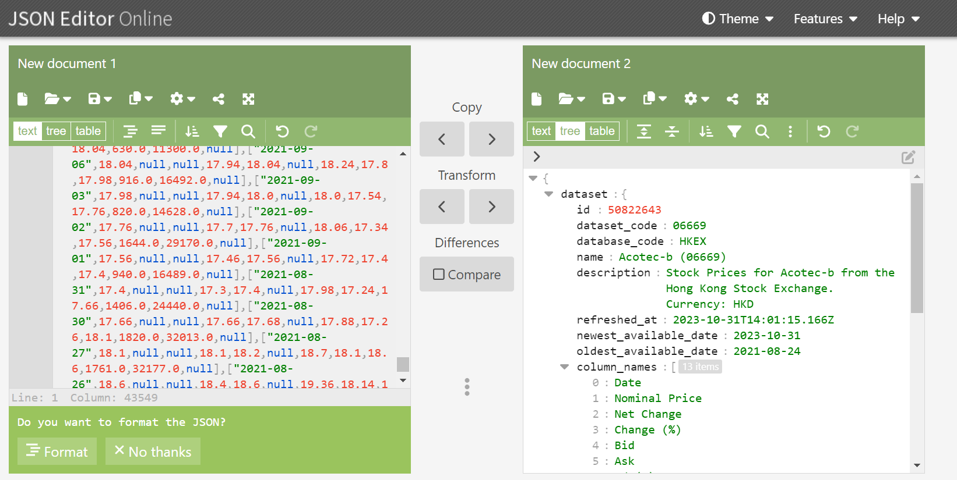

Slide 19
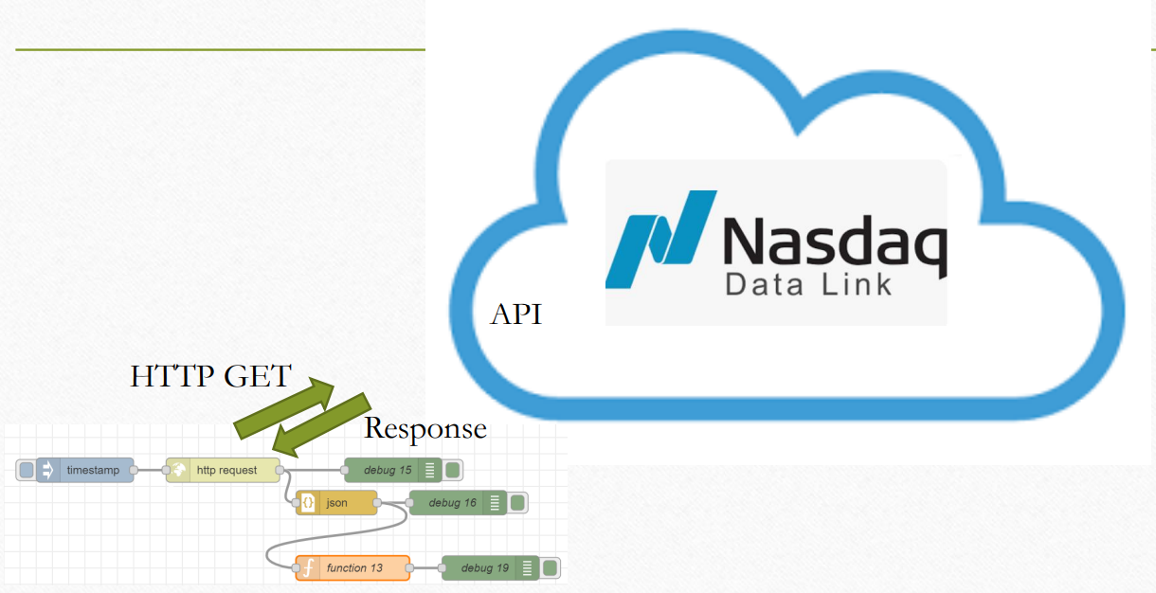
Exercise 8-2

Slide 20
json
Copy

Slide 21
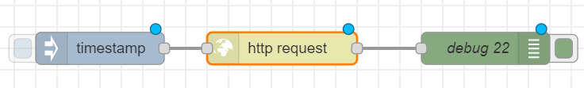
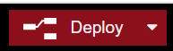
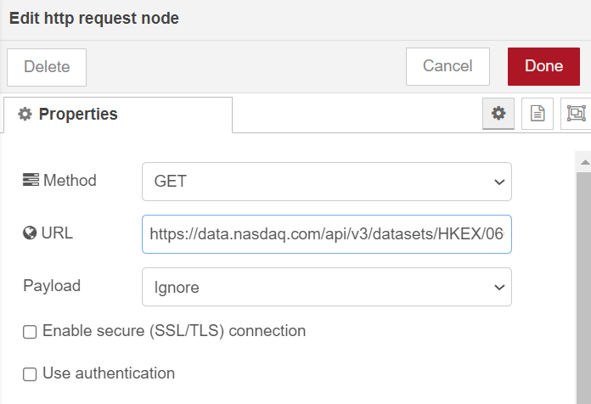
http request
Paste

Slide 22
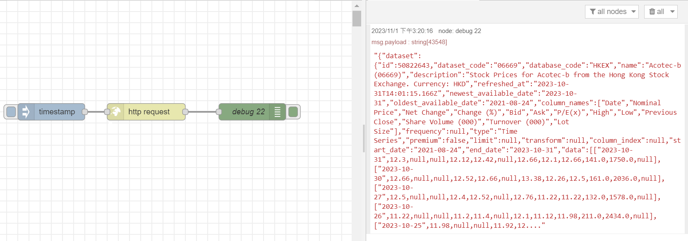
Trigger
Response
Click

Slide 23
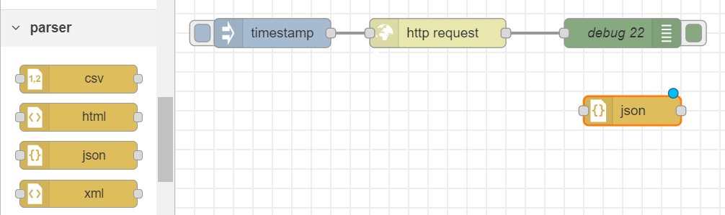
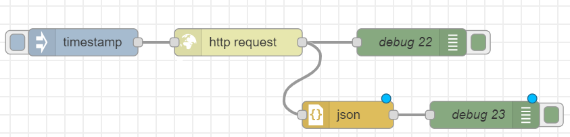
Add a “json” node

Slide 24
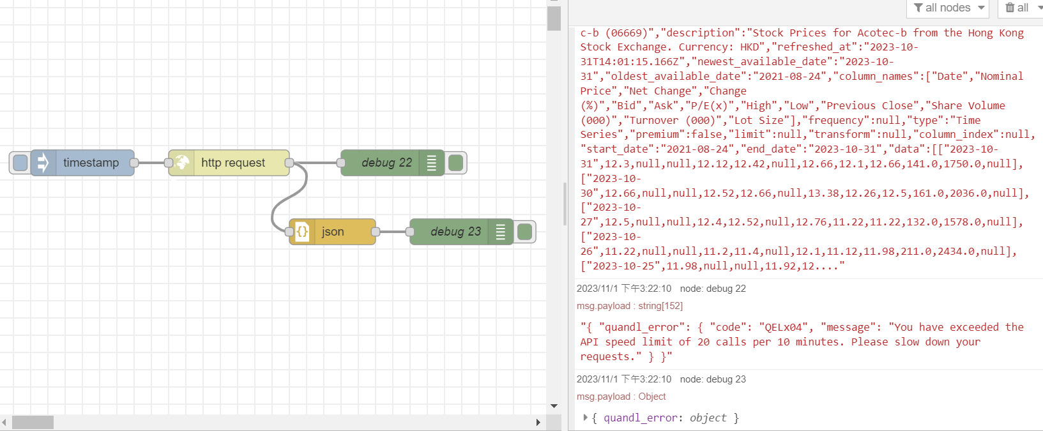
1. Click
2. Expand

Slide 25
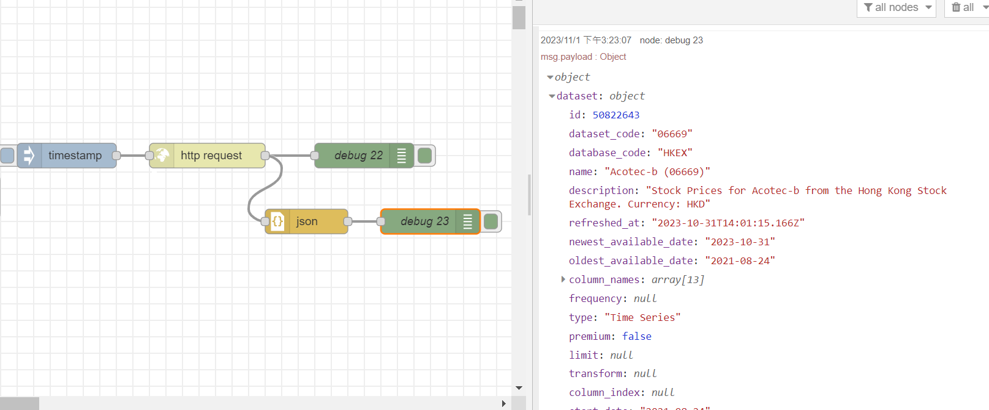

Slide 26
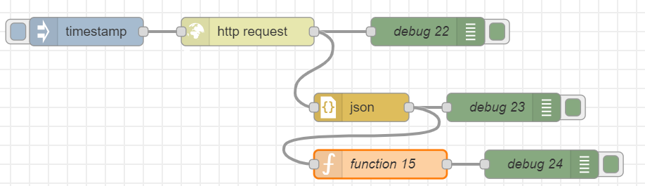
Add a function node and a debug node
var dataset=msg.payload.dataset;
msg.payload=dataset;
return msg;

Slide 27
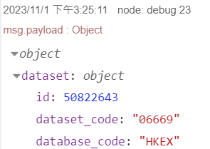
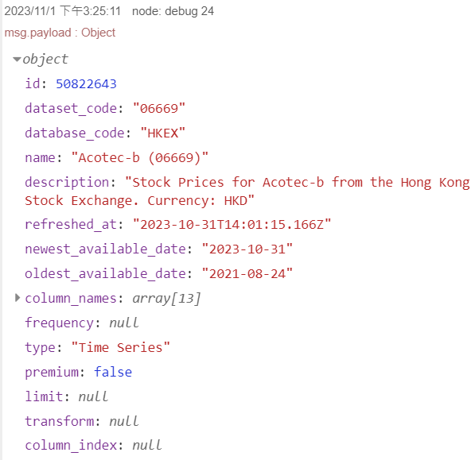
Trigger

Slide 28
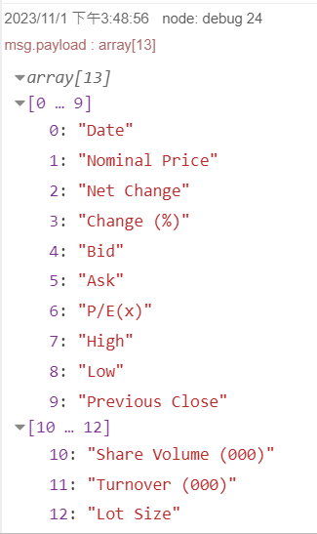
column_name
1. Click
var dataset = msg.payload.dataset;
var column_names = dataset.column_names;
msg.payload = column_names;
return msg;

Slide 29
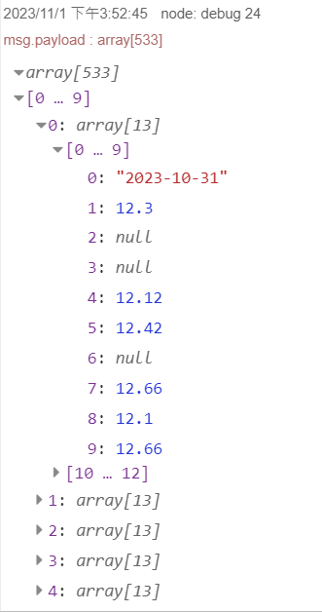
data
var dataset = msg.payload.dataset;
var column_names = dataset.column_names;
var data = dataset.data;
msg.payload = data;
return msg;

Slide 30
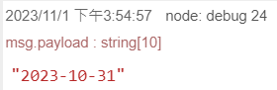
Show data[0][0]
var dataset = msg.payload.dataset;
var column_names = dataset.column_names;
var data = dataset.data;
msg.payload = data;
msg.payload = data[0][0];
return msg;

Slide 31
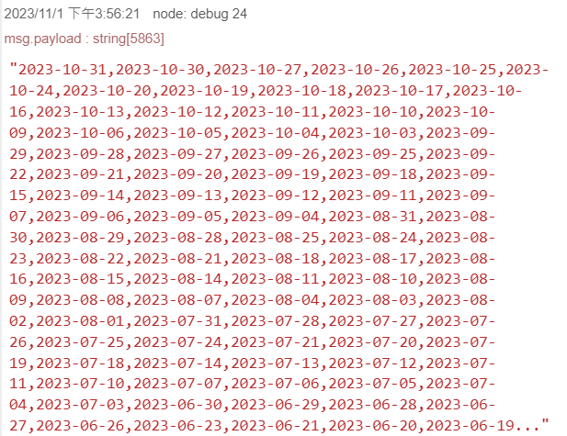
Process strings
var dataset = msg.payload.dataset;
var column_names = dataset.column_names;
var data = dataset.data;
msg.payload = data[0][0];
var alldate = "";
for (var i = 0; i < data.length; i++) {
alldate = alldate + data[i][0] + ",";
}
msg.payload = alldate;
return msg;

Slide 32
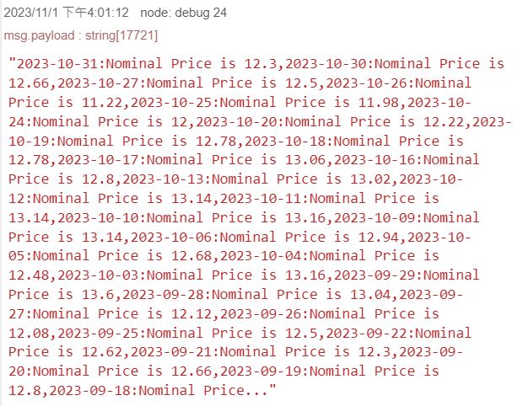
Process strings
var dataset = msg.payload.dataset;
var column_names = dataset.column_names;
var data = dataset.data; msg.payload = data[0][0];
var alldate = "";
for (var i = 0; i < data.length; i++) {
alldate
= alldate + data[i][0] + ":" + column_names[1] + " is " +
data[i][1] + ",";
}
msg.payload = alldate;
return msg;

Slide 33
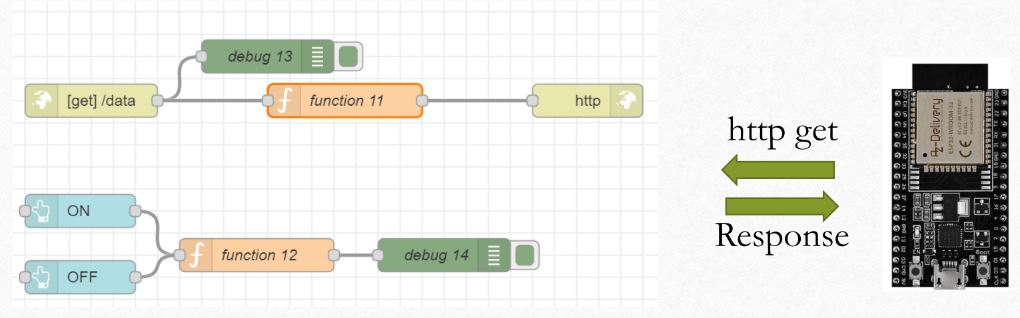
Exercise 8-3

Slide 34
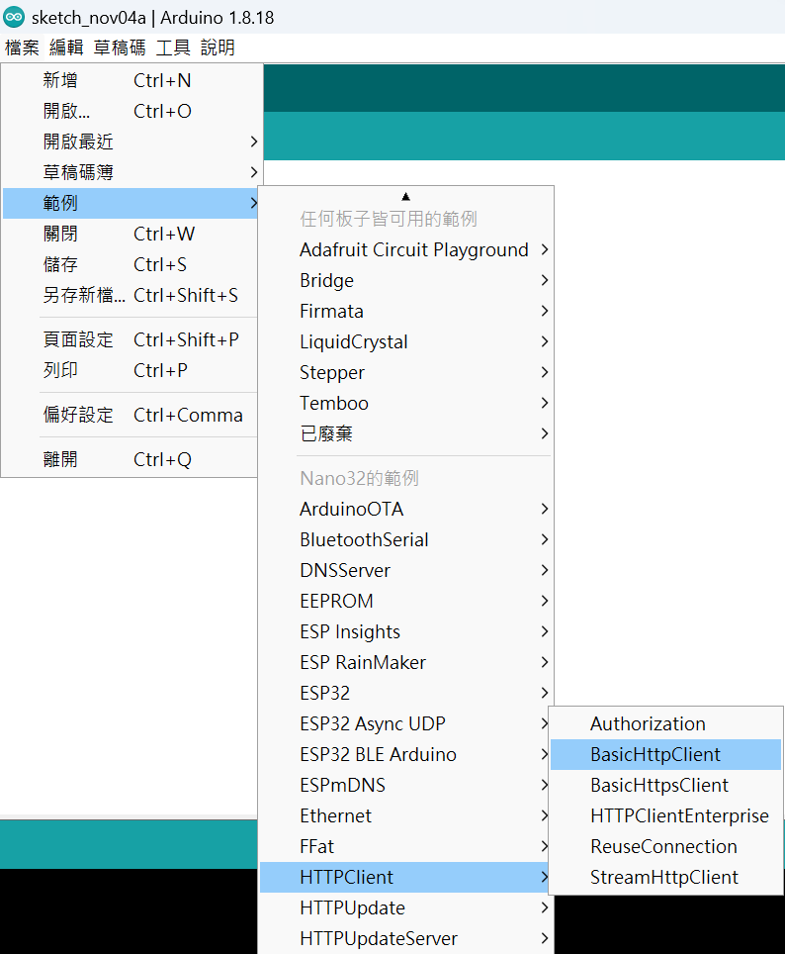
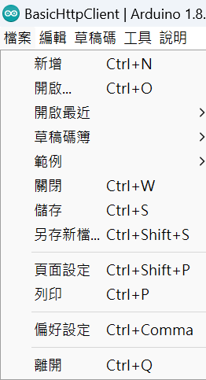
Example>>HTTPClient>>BasicHTTPClient

Slide 35
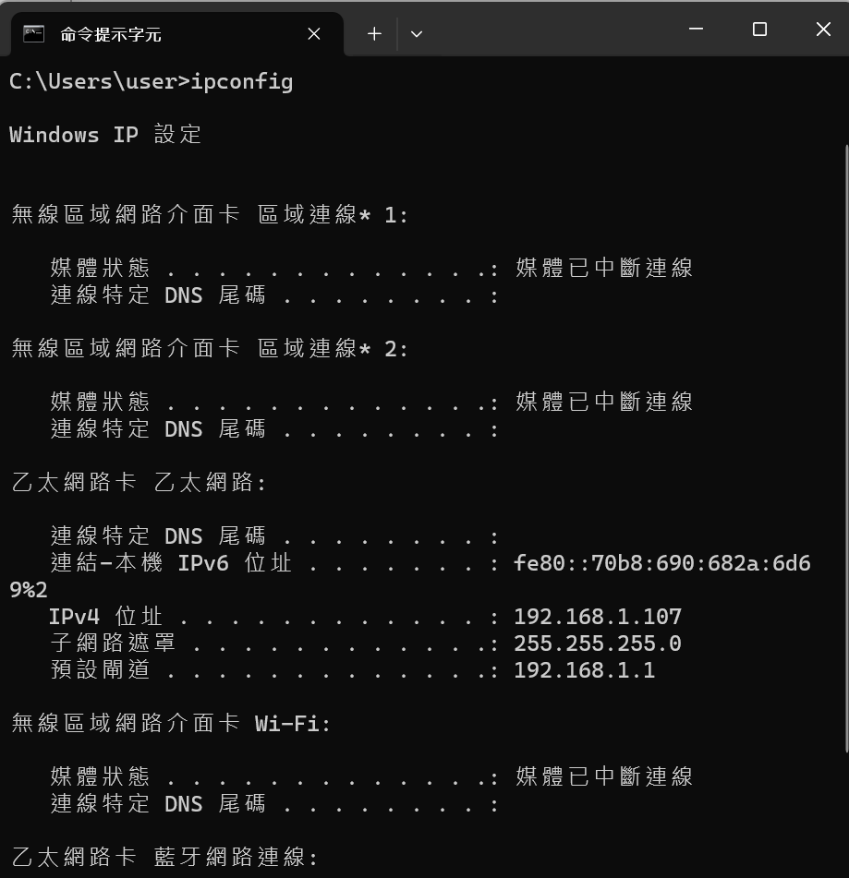
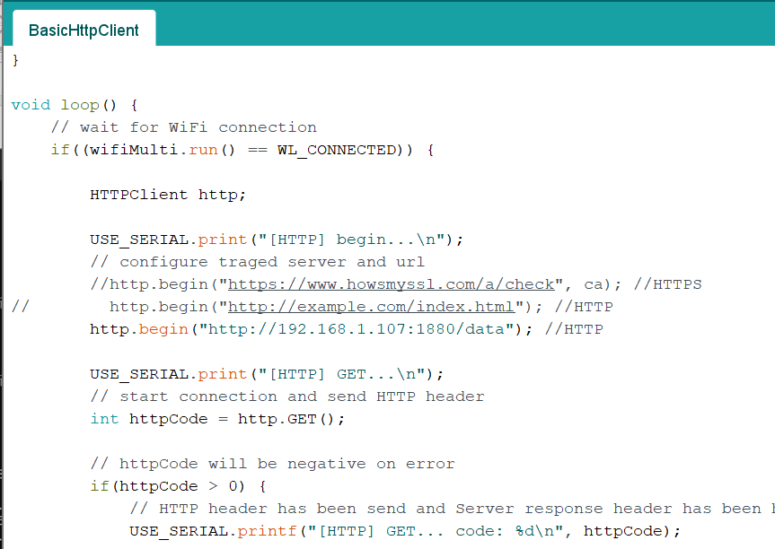

Slide 36
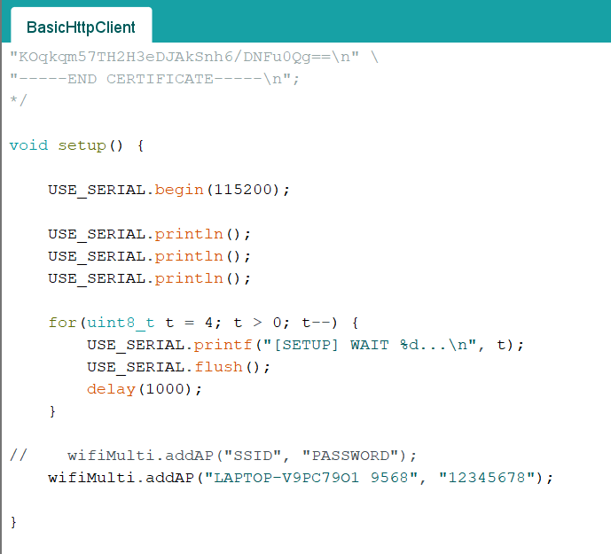
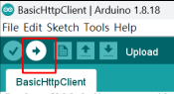
Edit BasicHTTPClient.ino
Upload

Slide 37
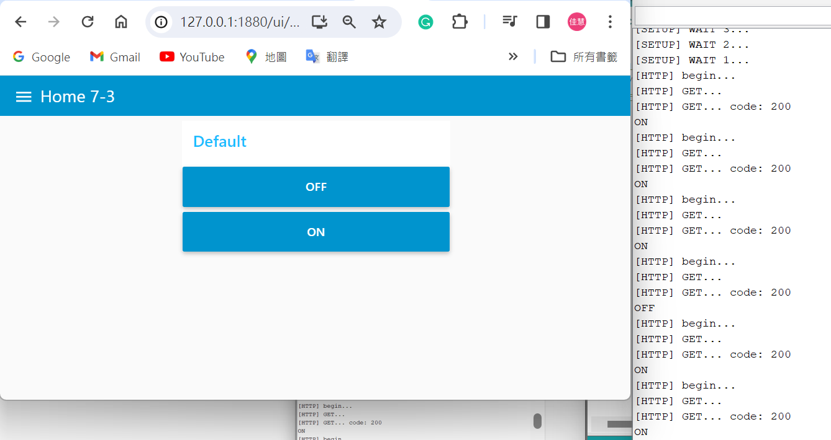
Result

Slide 38
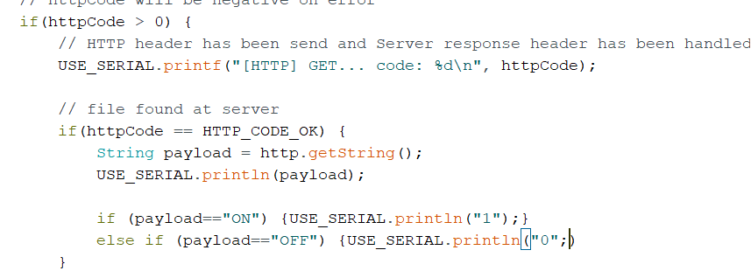
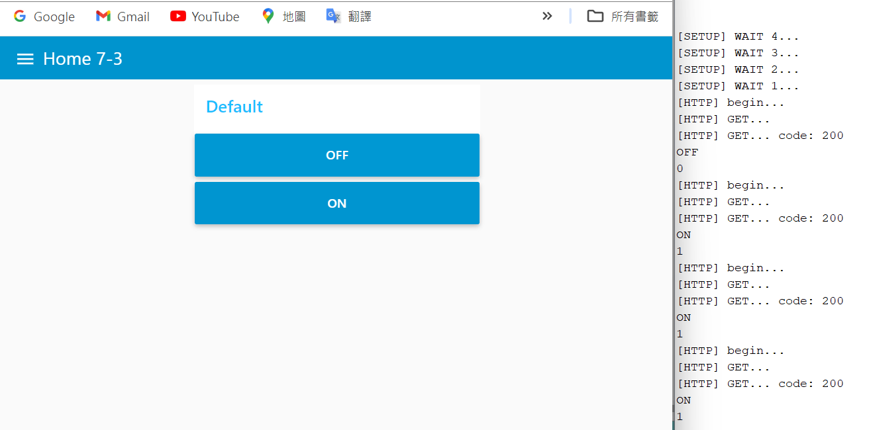
Edit
Result

Slide 39
Homework 8-1
1. Using the xml API for Hong Kong Exchange data in Nasdaq Data Link.
2. Using xml node to convert xml string to JSON object.

Slide 40
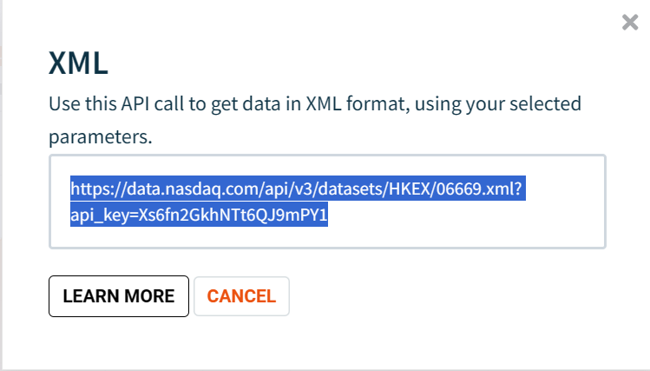
Using the xml API for Hong Kong Exchange data in Nasdaq Data Link
xml
Copy

Slide 41
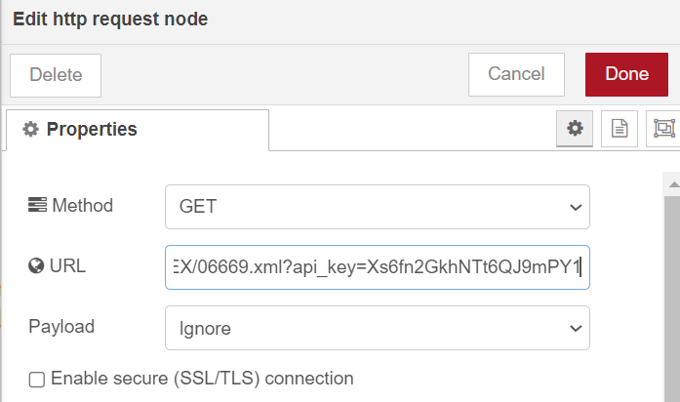
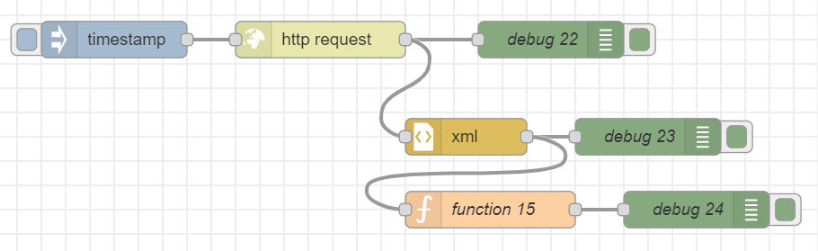
Using the xml API for Hong Kong Exchange data in Nasdaq Data Link
Paste

Slide 42
Using xml node to convert xml string to JSON object

Slide 43
Homework 8-2
1. Show data[0][1]
2. Show data[1][0]

Slide 44
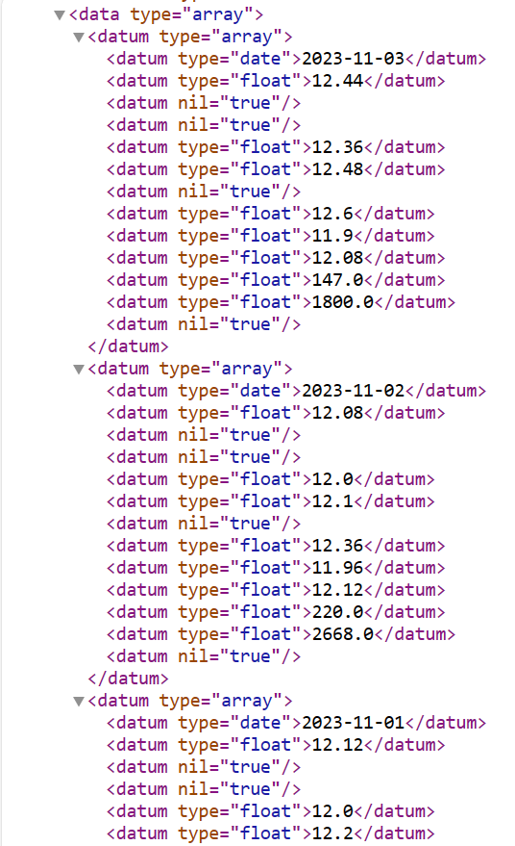

從json跟xml的data Link內容，可觀察到兩個的寫法不太一樣。所以我們要找到xml的寫法才可以輸出我們要的值。
json
xml

Slide 45


JSON
payload.dataset.data[0][1]
依題目找到對應xml的資料，方便等下確認結果是否正確。
Payload.dataset.data[0][1]
payload.dataset.data[1][0]
可點選Copy path來觀察程式路徑。
Result: payload.dataset.data[0][0]
可觀察到跟我們先前宣告變數取得的資料寫法一樣(var dataset=msg.payload.dataset;)，進而得知可從這裡來去找尋所需的資料路徑。
payload.dataset.data[1][0]

Slide 46



XML
payload[0].datum[1]._
payload[0].datum[0]._

Slide 47

Show data[0][1] & Show data[1][0]
var data = msg.payload["quandl-response"].dataset[0].data[0];
msg.payload = "data[0][1] :" + data.datum[0].datum[1]._ + “," + "data[0][1] :" + data.datum[1].datum[0]._;
return msg;
payload[1].datum[0]._

Slide 48

RESULT

Slide 49
Homework 8-3
Find another open data datasets. Make it more readable and build a REST
API
For example : PM2.5, UV index

Slide 50

https://data.gov.tw/

Slide 51

https://data.gov.tw/dataset/165286

Slide 52

https://odws.hccg.gov.tw/001/Upload/25/opendataback/9059/1514/eef510b3-662d-4d71-9fb1-d9a70e3ebfad.json
COPY

Slide 53


Paste

Slide 54
var data1 = "";
for (var i=0; i<msg.payload.length; i++) {
data1 = data1+"活動名稱: "+msg.payload[i]["活動名稱"]+"<br>"
+"縣市名稱: "+msg.payload[i]["縣市名稱"]+"<br>"
+"地點名稱: "+msg.payload[i]["地點名稱"]+"<br>"
+ "展演者: " + msg.payload[i]["展演者"] + "<br>"
+ "活動展演迄日: " + msg.payload[i]["活動展演迄日"] + "<br>"
+ "活動展演迄日: " + msg.payload[i]["活動展演迄日"] + "<br>"
+ "付費與否（活動售票與否）: " + msg.payload[i]["付費與否（活動售票與否）"] + "<br>"
+ "展演天數: " + msg.payload[i]["展演天數"] + "<br><br>"
}
msg.payload = data1;
return msg;

Slide 55

RESULT

Slide 56

Homework 8-4

Slide 57


Slide 58

Step 1:Test LED File>Examples>Basics>Blink

Slide 59

老師所使用的GPIO34在這裡無法使用。
可從圖片得到GPIO34,GPIO35,GPIO36,GPIO39只能當作input使用。所以我們須將GPIO換至這四個以外的GPIO才可使燈泡亮起。
我使用了GPIO32。

Slide 60


Edit
Save As

Slide 61

LED Blink Test
https://youtu.be/YG9OtYrk_F8

Slide 62


Step 2: Edit BasicHTTPClient.ino
1
3
4
2

Slide 63

Result

Slide 64

LED Blink
https://youtu.be/fuwg_khf7ZI

